Slide 1






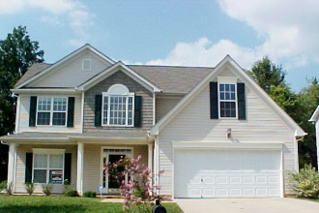


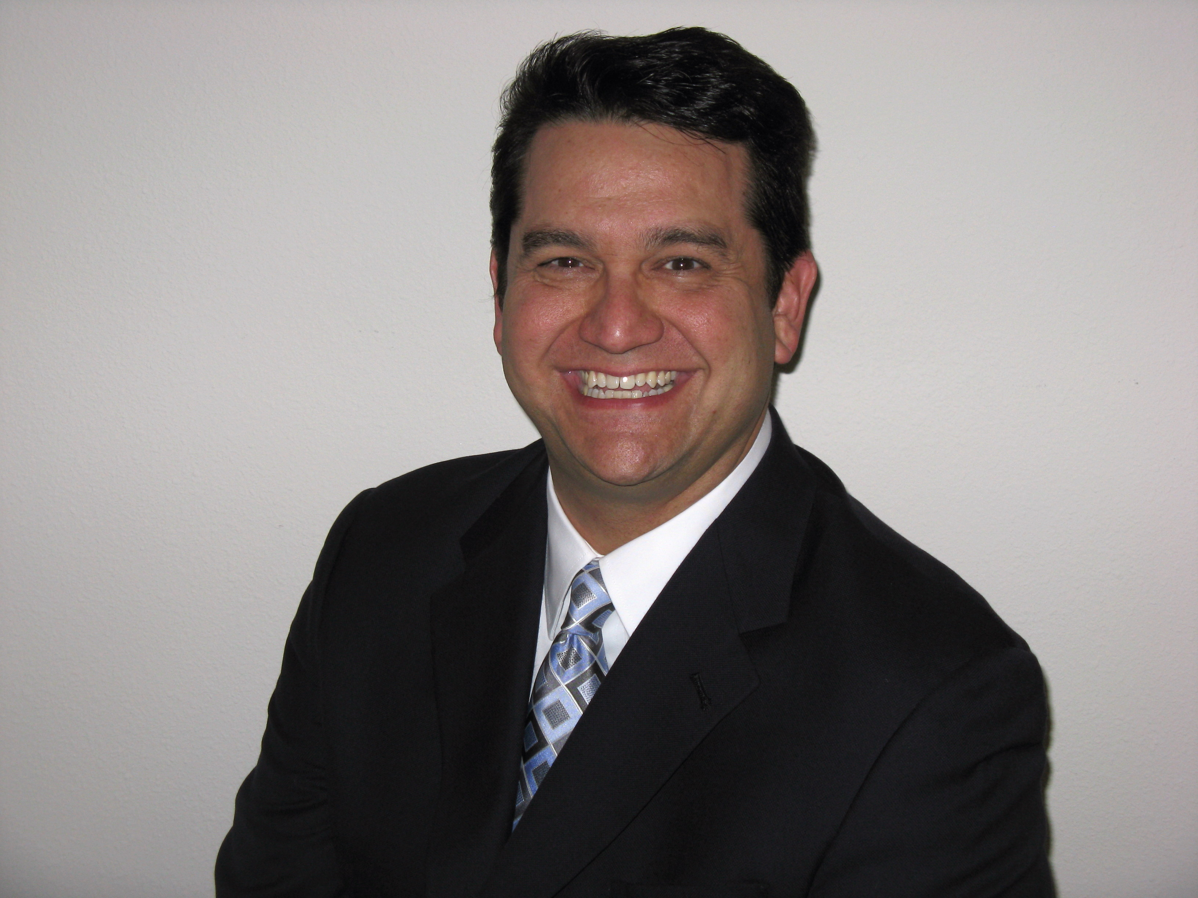


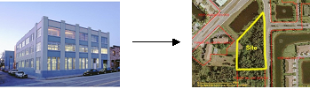
1031 Exchange Basics
Presented by:
Jeff Stechmann
Florida Business Development Director
Asset Exchange Company, LLC
(813) 999-2524
jeff@ax1031.com
1

Slide 2

Asset Exchange Company
In business since 2006
Conducted over 30,000 1031 Exchanges
National Qualified Intermediary “QI”
CA Franchise Tax Board
Principle Owners over 20 Years in 1031 Business
Tax Attorney
Free Audit Support

Slide 3


1031 Exchange History
History of Exchange
1921 – Farmland swap
1979 – T.J. Starker

Slide 4
The Code
IRC Section 1031?
Investment Real Estate
Tax Deferral
"No gain or loss shall be recognized on the exchange of property held for productive use in a trade or business or for investment, if such property is exchanged solely for property of like-kind which is to be held either for productive use in a trade or business or for investment."

Slide 5

Like-Kind Property
  Like kind – any real property for any other real property
    Single family residential for an apartment complex
    Duplex for a fourplex
    Industrial property for rental resort property
    Single family residential for a downtown commercial
        Any Domestic Property

Slide 6
Intent to Hold for Investment
“Intent” is the taxpayer’s subjective intent
The IRS will look at factors that either support or negate the taxpayer’s intent to hold for investment
All facts and circumstances taken into account
The holding period is one (of many) factors
Ideally the taxpayer has multiple factors to establish the intent to hold for investment
Reesink v. Commissioner (April 23, 2012) (8 month moved in)

Slide 7
Vacation Homes
Revenue Procedure 2008-16
Creates a safe harbor for vacation home exchanges.
IRS will consider a dwelling unit held for investment
if certain requirements are met.
Requirements:
Must own the property for at least 24 months.
For each 12 month period must.
Rent the property out at fair market value for at least 14 days.
Can use it personal for 14 days or 10 percent of the total time it was rented.

Slide 8
Why is an Exchange Beneficial to Realtors?
Two Transactions - Two Commissions
Equal of greater value - Larger Commissions
1031 Tax Savings Benefit
Seller of Clients replacement property
Proactive tool to find new non-owner occupied clients

Slide 9
1031 Guidelines
Basic Requirements
Property Qualifications
Tax Deferral Requirements
Timeline
Identification Rules

Slide 10

Guideline #1
Property Qualifications
  Property held for productive use in a trade or business or for investment.
  Like kind – any real property for any other real property

Slide 11
Guideline #1
Property Qualifications
    What Property is Excluded?
  Primary Residence
  Property Held for Sale
  Dealer Property
  Foreign property

Slide 12
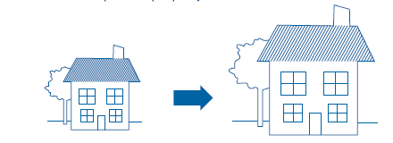
Guideline #2
Tax Deferral Requirements
  Reinvest all of the net proceeds in property of equal or greater value.
  Acquire an equal amount or greater debt.
  QI holds the net proceeds on the Sellers behalf

Slide 13
Guideline #3
Timeline
  180 days - or the date you are required to file your tax return with extensions.
  45 day identification period.
0
45
180
Close of
Escrow
Identification
Letter Due
Exchange
Completed

Slide 14
Guideline #4
Identification
  3 Property Rule - Can identify up to three properties without regard to the fair market value of those 3 properties.
  200% Rule – Can identify over 3 properties but can not exceed 200% or 2x the combined fair market value of the property being sold.
  95% Rule – Can identify over 3 properties and exceed the 200% rule, must acquire at least 95% of the value of all the properties identified.

Slide 15

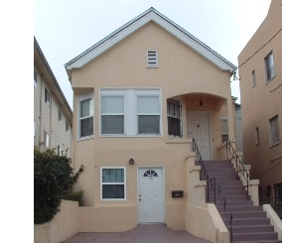
Guideline #4
3 Property Rule
$1M
$1M Sale
$1M
$3M Identified
$1M

Slide 16

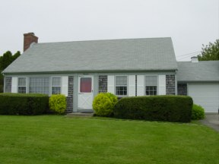
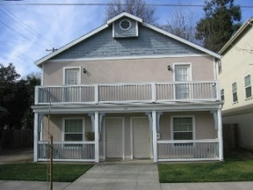
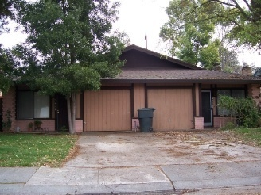
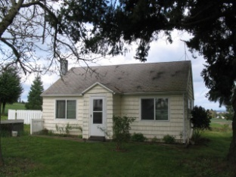
Guideline #4
5 Identified
200% Property Rule
$1M Sale
200%
$Can’t exceed $2M Combined

Slide 17

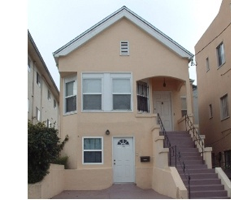


Guideline #4
10 Identified
95% Property Rule
$1M Sale
$1M Each
$10M Identified
95%
$10M Identified, Need to acquire $9.5M

Slide 18

Exchange Process
SALE
Contract gets assigned
PURCHASE
Contract gets assigned
Exchanger
Direct Deed
Direct Deed
Buyer
Seller
$
$
Identification Period
Exchange Period
0
45 Days
180 Days

Slide 19
1031 Exchange Types & Fee
Types of Exchanges & Fee
Delayed Exchange
  Sell first, then buy
  $750 Sale + $200 Purchase = $950 (1/1)
Reverse Exchange
  Buy First, then sell
  Start at $6,500 (based on complexity)
Construction/Improvement Exchange
  Use 1031 Exchange Funds to improve/build a property
  Start at $6,500 (based on complexity)

Slide 20

Contact Info
I’d love to answer any questions you or your clients may have
Asset Exchange Company
Contact: Jeff Stechmann
Direct: 813.999.2524
Email: jeff@ax1031.com
Web: www.ax1031.com

