Slide 1






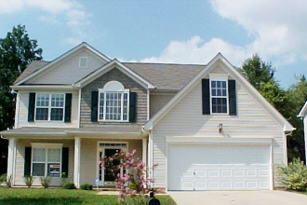





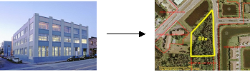
Advanced 1031 Exchange Strategies
Presented by:
Jeff Stechmann
Florida Business Development Director
Asset Exchange Company, LLC
(813) 999-2524
1

Slide 2

Asset Exchange Company
In business since 2006
Conducted over 30,000 1031 Exchanges
National Qualified Intermediary “QI”
CA Franchise Tax Board
Principle Owners over 20 Years in 1031 Business
Tax Attorney
Free Audit Support

Slide 3
Why Exchange?
Why Investors Exchange:
Tax Deferment
1/3 of total gain goes to pay taxes
Buy “MORE” Property
Utilize “saved/deferred taxes to leverage into a larger property with better cash flow
Diversification & Management Relief
Geographic diversification.
Multiple properties exchange into one property.
Estate Planning
No limit on how many times you can exchange
Step up in basis.

Slide 4
Tax Rates
Federal Taxes
Federal Capital Gains Tax: 15%
Income >$400K/$450K 20%
Depreciation Recapture: 25%
Medicare Tax: 3.8%
In 2013, 3.8% Medicare tax on all unearned income from interest, dividends, annuities, royalties, capital gains and rents for individuals who earn more than $200,000 annually and joint filers reporting more than $250,000.
Also subject to state income tax rates for states that collect state income taxes, non residents included.

Slide 5
Gain Calculation
Facts:
$500,000 purchase price
$25,000 capital improvements
$100,000 depreciation
$1,000,000 sales price
Gain Calculation:
Sale Price
(Adjusted Basis)
Gain
$1,000,000
($425,000)
$575,000
Taxes:
25% Dep. Recapture
$100,000 x 25% = $25,000
20% Fed. Cap Gains
$475,000 x 20% = $95,000
3.8% Medicare Tax
$475,000 x 3.8% = $18,050
Total Taxes Due: $138,050
Adjusted Basis
Purchase Price
+Capital Improvements
(Depreciation)
Adjusted Basis
$500,000
$25,000
$100,000
$425,000

Slide 6
Tax Advantages - Selling
IRC Section 1031?
Real Estate used in Trade or Business or for Investment
Tax Deferral
  Defer taxes on all the gain if requirements are met
  Properties must me held for investment or business use
IRC Section 121?
Primary Residence
Tax Exemption
  Must occupy as primary residence for two of the last five years
  $250K single
  $500K married

Slide 7
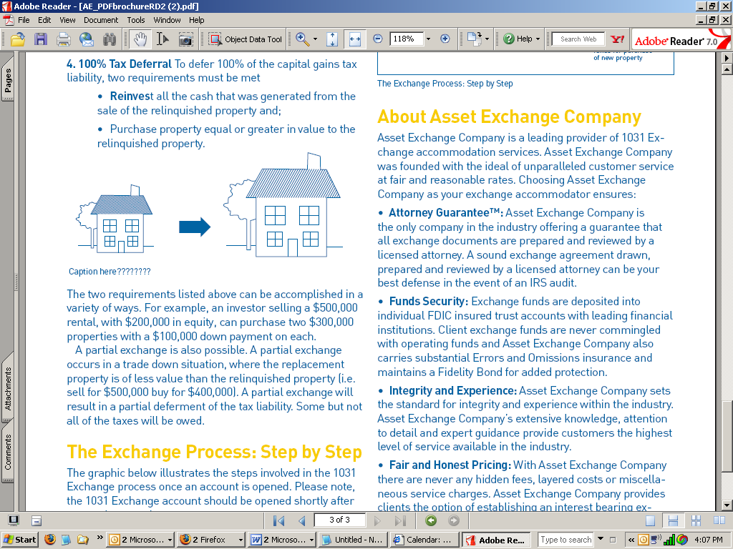
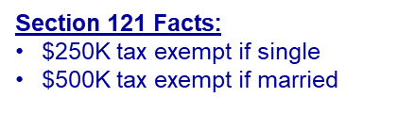
Using Section 121
Primary Residence:
Primary – 5+ years
2010
Acquire Primary $100K
2016
- Sell Property for $1MM
Sell Property $1MM
Gain of $900K
  $500K of gain tax exempt
  - $400K of gain taxable = $130K in taxes
Tax Implication: $130,000

Slide 8
Using 121 & 1031 Together
Primary Residence to Rental:
Primary – 5+ years
Rental – 2 years
2010
Acquire Primary $100K
2016
- Convert to Rental
2018
- Sell Property for $1MM
Sell Property $1MM
Gain of $900K
  $500K of gain tax exempt (Section 121)
  - $400K of gain taxable defer $130K in taxes (Section 1031)
Tax Implication: $0.00

Slide 9

Using 121 & 1031 Together
Split Treatment:
Sale of a Fourplex
3 Units rented
1 Unit primary residence
1031
1031
121
1031
Primary Residence
Use 1031 Exchange on ¾
Use Section 121 on ¼

Slide 10
Who can do a 1031 Exchange?
Taxpayer who sells must be the same taxpayer who buys!
Individuals
  Individual persons
  Husband and Wife – If spouse acquires property when single, spouse is the tax payer
Tenant in common owners
Limited Liability Companies (LLC’s) & Partnerships
  Single member LLC – Individual is tax payer if disregarded entity
  Multi member LLC – LLC is tax payer, regarded entity - LLC owns property not individual partners
Corporations – Corporation is tax payer not the shareholders
Trust – Revocable or Irrevocable Trust

Slide 11
Partnership Exchanges
A Partnership/LLC Owns Real Property
  The Partnership/LLC is the owner of the real property not the individual partners
  Some partners may want the partnership to stay together and do a 1031 exchange
  Some partners may want to receive cash and pay the taxes owed.

Slide 12
Partnership Exchanges
“Drop and Swap”
  Members “drop” the LLC and take title individually as tenants in common
  Season the tenants in common ownership for 1-2 years
  Sell “swap” the property and owners can do what they wish (sale or exchange) with their respective interests
“Swap and Drop”
  Sell “swap” the property as an LLC
  Exchange into as many replacement properties as you have members
  Season LLC Ownership of the replacements for 1-2 years
  Members “drop” the LLC and distribute assets to members

Slide 13
Why is an Exchange Beneficial to Realtors?
Two Transactions - Two Commissions
Equal of greater value - Larger Commissions
Seller of Clients replacement property
Clients 1031 Tax Savings Benefit
Proactive tool to find new non-owner occupied clients

Slide 14
1031 Guidelines
Basic Requirements
Property Qualifications
Tax Deferral Requirements
Timeline
Identification Rules

Slide 15

Guideline #1
Property Qualifications
  Any real property held for productive use in a trade or business or for investment – whether improved or unimproved – is considered “like-kind.”
  Like kind – any real property for any other real property
      Any Domestic Property

Slide 16
Guideline #1
Property Qualifications
    What Property is Excluded?
  Primary Residence
  Property Held for Sale
  Dealer Property
  Foreign property

Slide 17
Guideline #2
Tax Deferral Requirements
  Reinvest all of the net proceeds in property of equal or greater value.
  Acquire an equal amount or greater debt.
  QI holds the net proceeds on the Sellers behalf.

Slide 18
Guideline #2
Tax Deferral Requirements
  Reinvest all of the net proceeds in property of equal or greater value.
  Acquire an equal amount or greater debt.
The Exchange Equation
 | Relinquished | Replacement | Boot
Value | $1,000,000 | $1,200,000
- Debt | $300,000 | $550,000 | $ 0
- Cost of Sale | $50,000
Net Proceeds | $650,000 | $650,000 | $ 0

Slide 19
Boot!
Tax Deferral Requirements
  Reinvest all of the net proceeds in property of equal or greater value.
  Acquire an equal amount or greater debt.
 | Relinquished | Replacement | Boot
Value | $1,000,000 | $800,000
- Debt | $300,000 | $250,000 | $ 50,000
- Closing Costs | $50,000
Net Proceeds | $650,000 | $550,000 | $ 100,000
Total Boot |  |  | $ 150,000
Analysis: This results in a total of $150,000 in boot.
($50,000 in mortgage boot and $100,000 in cash boot = $150,000)

Slide 20
Guideline #3
Timeline
  180 days
  45 day identification period.
0
45
180
Close of
Escrow
Identification
Letter Due
Exchange
Completed

Slide 21
Guideline #4
Identification
  3 Property Rule - Can identify up to three properties without regard to the fair market value of those 3 properties.
  200% Rule – Can identify over 3 properties but can not exceed 200% or 2x the combined fair market value of the property being sold.
  95% Rule – Can identify over 3 properties and exceed the 200% rule, must acquire at least 95% of the value of all the properties identified.

Slide 22

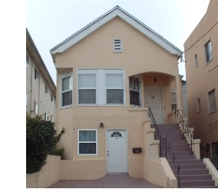
Guideline #4
3 Property Rule
$1M
$1M Sale
$1M
$3M Identified
$1M

Slide 23

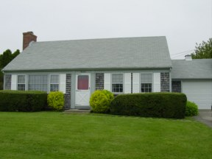
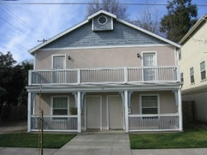
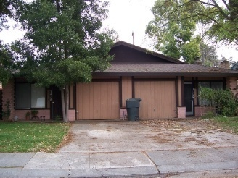
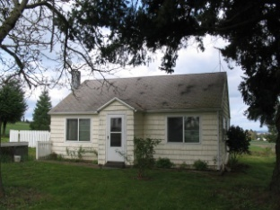
Guideline #4
5 Identified
200% Property Rule
$1M Sale
200%
$Can’t exceed $2M Combined

Slide 24

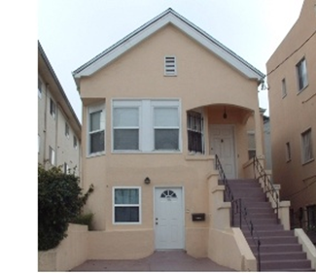

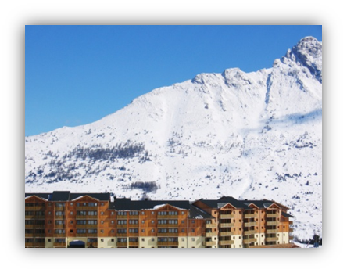
Guideline #4
10 Identified
95% Property Rule
$1M Sale
$1M Each
$10M Identified
95%
$10M Identified, Need to acquire $9.5M

Slide 25
Reverse Exchanges
Reverse Exchanges
  Buy First, then sell
Replacement
Relinquished
  EAT/LLC warehouses the “replacement property”
  Exchanger operates property under a NNN lease agreement
  Exchanger takes title when relinquished property sells
  Relinquished property must sell within 180 days
  Property sells, taxes deferred
  Property does not sell, client owns 2 properties

Slide 26
Reverse Exchange
Why do a Reverse Exchange?
Positives
  Sellers Market – Need to act fast or your replacement property will be sold
  Poor Planning – My property isn’t selling when I thought it should and I’ve already made an offer
Negatives
  Lender may have issues lending to an EAT/LLC
  Need to sell relinquished property in 180 days

Slide 27
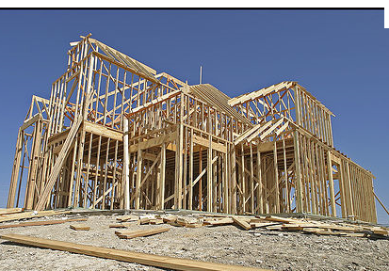
Construction Exchanges
Construction Exchanges
  Use 1031 Exchange Funds to improve/build a property
  Relinquished property sells
  Net proceeds sent to QI
  EAT/LLC parks the replacement property”
  QI holds remaining funds
  QI disburses all funds to contractors
  Exchanger manages all construction
  EAT/LL transfers new/improved
  property to Exchanger by day 180

Slide 28
No Appreciation Exchanges
Example
Facts:
$1,000,000 purchase price
$1,000,000 sales price
Problem:
$200,000 depreciation
- Depreciation lowers basis
Tax Liability:
25% Depreciation Recapture Tax
$50,000 federal depreciation tax bill

Slide 29
Vacation Home Exchanges
Revenue Procedure 2008-16
Creates a safe harbor for vacation home exchanges.
IRS will consider a dwelling unit held for investment
if certain requirements are met.
Requirements:
Must own the property for at least 24 months.
For each 12 month period must.
Rent the property out at fair market value for at least 14 days.
Can use it personal for 14 days or 10 percent of the total time it was rented.

Slide 30

Contact Info
Asset Exchange Company
Contact: Jeff Stechmann
Direct: 813.999.2524
Email: jeff@ax1031.com
Web: www.ax1031.com

